Slide 1
Hyperparameter Db
Code-Progress Report
Mansi Nagraj 001427101
Mayur Vyas 001495686
Dhawal Priyadarshi 001401831

Slide 2
Index
Introduction
Project Objective
Tasks accomplished: (a) Understanding the received data (b) Conceptual Diagram - MetaData of the Dataset - Hyperparameter Model - Final Conceptual Diagram
Plan Ahead

Slide 3
Introduction
The hyperparameter database to be developed as a part of this project is a source with algorithms, tools, and data that allows users to visualize and understand how to choose hyperparameters that maximize the predictive power of their models.
The project involves gathering the data in json files containing predicted target variables, hyperparameters, meta-data etc. by running different models (with varying hyperparameters) on a single dataset using H2O then using the same data to build the database, writing use case to get desired data.

Slide 4
Project Objective
The project aims at designing a database that makes the storage and retrieval of relevant datasets and hyperparameter values for different machine learning algorithms, easy for the user.
This includes curating datasets for modeling and organizing hyperparameter metadata in a fully normalized (3NF) and optimized database with related functions, procedures, triggers for different use cases.

Slide 5
Understanding the received Data:
Following were the files shared by the Data-Science team:
1) Metadata.csv >> Data about the data set (like column names, datatype, type of variable)
2) XBL7h1dtl_300_Leaderboard.json >> Automl leader board generated for run time of 300 seconds(has models and their evaluation metrics)
3) XBL7h1dtl_300_Metadata.json >> Metadata about the leader board generated (like server path, file name, run time, run id etc.)
Hyperparameter Files:
5 different models were generated for a 300 sec runtime in H2O
GBM_1_AutoML_20190410_190849_hyparameter.json
GBM_2_AutoML_20190410_190849_hyparameter.json
GLM_grid_1_AutoML_20190410_190849_model_1_hyparameter.json
StackedEnsemble_AllModels_AutoML_20190410_190849_hyparameter.json
StackedEnsemble_BestOfFamily_AutoML_20190410_190849_hyparameter.json

Slide 6
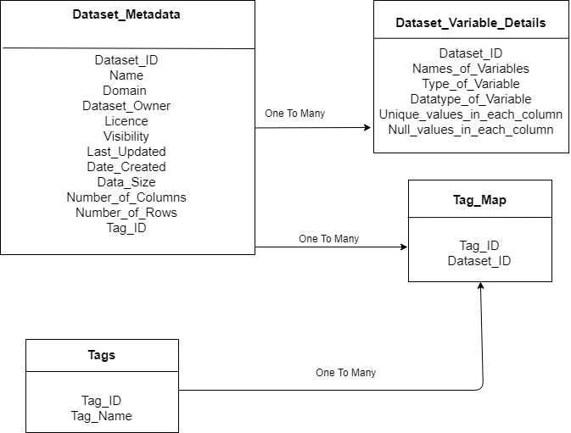
Conceptual Diagram (MetaData of the Dataset):

Slide 7
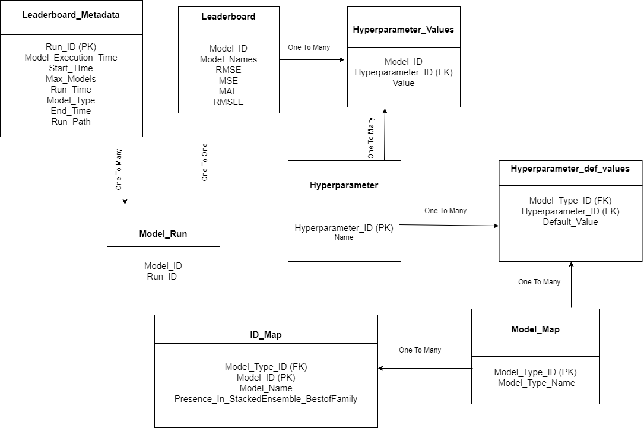
Conceptual Diagram (HyperParameter model):

Slide 8
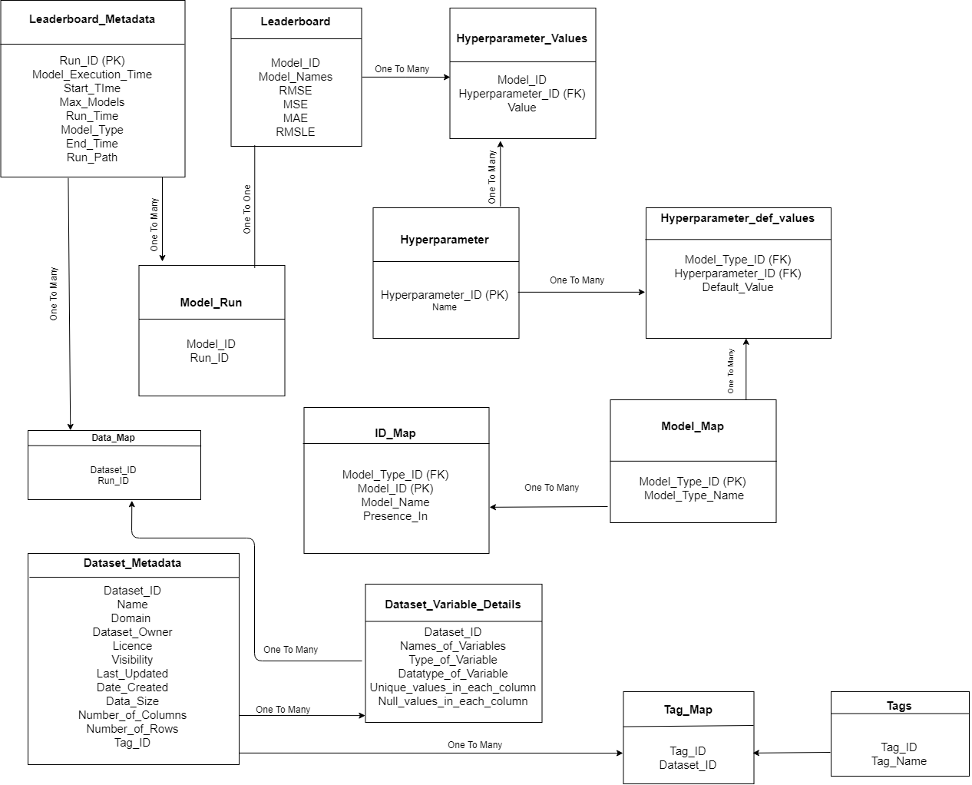
Conceptual Diagram (Combined..):

Slide 9
Plan Ahead
Triggers
Create triggers to auto-update data in the tables whenever a new Folder (outcome from H2O having JSON files) is generated
Stored procedures for important use-cases:
Suggest Data-sets used by other users based on industry-domain, Model-Type (Predication/classification), algorithm(Linear/logistic/generalized) etc
Display 10 latest analysis (Use-case Ids and Description) based on industrial domain & date-time of model run
Get details of the model based on the conditions under which model was tested: time of run, no. of models generated, names of models, accuracy, presence in best model of the run

Slide 10
Plan Ahead Contd..
Functions for important use-cases:
Return the values of the hyperparameter based on model-type, algorithm along with accuracy of that test
Get average number of models generated for a particular run time and datasets from a particular domain (finance/health care/ education) with similar datasize (Number of rows, columns)
Recommend the most commonly used algorithm used by other users for a similar target variable and Model-type based on no. of visits to the dataset and matching target variable and model-type
Idea for implementation:
Introduce Calculated data: % of used cases of each type
Order by the calculated field
Select TOP ⅗ best results

